Slide 1
UK Environmental Observation Framework

Slide 2
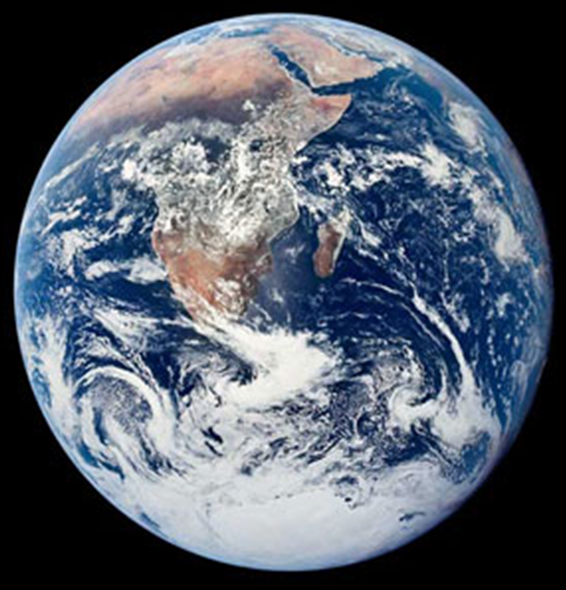
Environmental Observations
Vital source of information from global to local scale for:
understanding and managing our changing environment
guiding current and future policy, science and innovation
economic benefit and quality of life
Notes:
Why do we need observations?
UKEOF aims to raise the profile of ongoing observation needs and ensure that longer-term observations/ monitoring and surveillance are as valued as other forms of information such as research, economics etc.

Slide 3
Environmental Observations – the picture in 2007
Fragmented
Uncoordinated
Lacks strategic direction
No overall owner
Risk of:
Missed opportunities
Poor data sharing
Funding stopped for key time series
Duplication of effort
Refs: ADAS (2006); UKMMAS, Defra, (2005); GECC (2006)
Notes:
WHY does UKEOF exist? – The background
A study completed by ADAS (for ERFF) in 2006 showed that environmental monitoring in the UK was fragmented, uncoordinated etc.
We didn’t even know the magnitude of what was being invested in this area.
Ultimately best use was not being made of UKs effort in environmental observations
A recommendation was to produce a coherent Strategy for Monitoring across the UK.

Slide 4
UKEOF Launched July 2008 to:
Develop holistic picture of the observational needs of the UK and the role of such observations
Share Knowledge & Information
Understand use of observation data & tools for knowledge transfer
Enable funding mechanisms for long-term observations
Build strong community to share data & expertise
Notes:
The UKEOF was launched in 2008. There are 5 main areas to address.

Slide 5
The Partners
“Working collaboratively to maximise the value of the UK’s environmental observations"
Notes:
To deliver on these objectives UKEOF is formed as a partnership of 15 organisations across the UK representing the major public sector funders of environmental observations – covering an investment of at least £300m per annum
NI has been involved but is currently not able to be on the MG

Slide 6
UKEOF Management
Owned by LWEC Members
Guided by UKEOF Management Group
Programme progressed by Secretariat & Stakeholders
Advised by Data Experts and Steering Groups
Notes:
UKEOF is the core observational activity of LWEC, .but is separately funded

Slide 7
What progress has been made?
Phase 1 focussed on the development of tools for use by partners and stakeholders
Catalogue
Cost guidance
Statement of Need
Assessment Tool
Data Advisory Group
Decision Support Framework
Online searchable metadata database of environmental observation activities
Help assess the cost of observing
Start to understand the evidence needs for observational activities
Assess activities against need
Promote sharing of data and information
Help make decisions on uses and funding of observations
Notes:
These activities provided the knowledge base – WHO is monitoring WHAT, WHERE and WHY and at what COST
The catalogue was the first of its kind.
Through the development of these tools strong working relationships have been built at the Management Group level between the different organisations so that further activities can be undertaken

Slide 8
What progress has been made?
Phase 2 is focussing on:
Uptake of tools by the partners - Catalogue upgrade
Providing a neutral space for discussion
Priority areas where a UK forum can add value
Coincidence mapping
Citizen Science
Coordinating climate observations
Sustainable funding mechanisms
Notes:
Now that we have the foundations we are concentrating on the uptake of tools – such as using the catalogue to support partners activities
Neutral space – discuss efficiencies and collaborative working e.g. Coincidence Mapping – geographic coincidences of monitoring activities – key importance to Defra who are currently running a large strategic alignment project to look to see where efficiencies can be made
Co-ordinating climate observations is overseeing co-ordination of the UK’s contribution to the Global Climate Observing System – DECC led, but key interest to NERC, Met Office

Slide 9
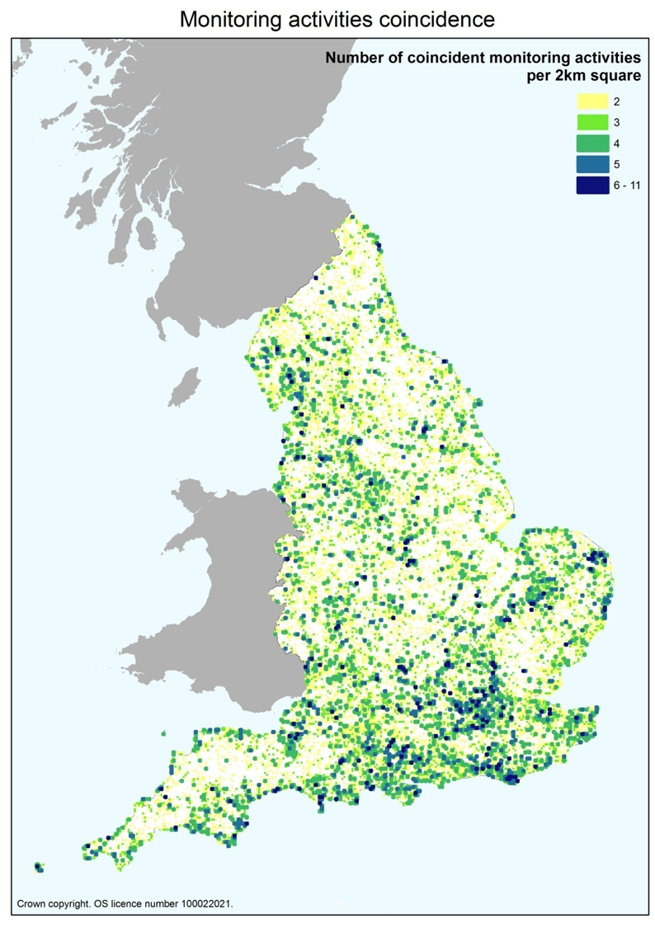
Coincidence Mapping
Finding opportunities to improve monitoring activities
Initial study led by NE identified a high number of geographic coincidences in monitoring activities
Notes:
Information on 64 activities gathered in total, from NE and partners
7 UKEOF MG orgs provided information on 40 monitoring activities
UKEOF orgs - FC, EA, CCW, Met Office, NERC (BGS & CEH), Defra (AEA), and JNCC were able to provide their own information plus sites from GWCT, BTO, BC & BTC
NE analysis utilised 35 ‘separate monitoring activities’

Slide 10
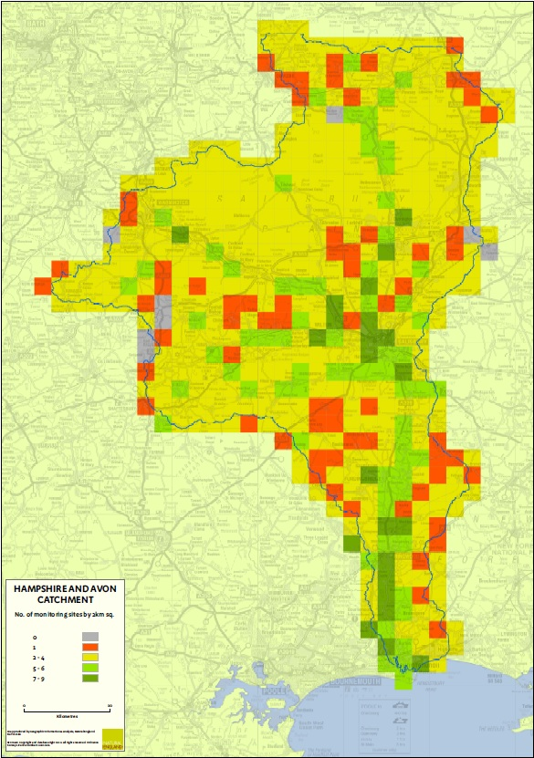
Coincidence Mapping
A case study is being run in the Hampshire Avon catchment to identify real opportunities for collaboration
15 different organisations attended a workshop in the catchment to discuss collaborative working over their monitoring
A best practice guide will be produced as an output of the work
Notes:
Following the initial work by NE this case study is being run to see what the real opportunities for collaboration are from these geographic coincidences in monitoring.
Individual actions were identified at the workshop, and these fill be followed up on and the impact of this work assessed in April 2014, after which best guidance advice will be produced.

Slide 11
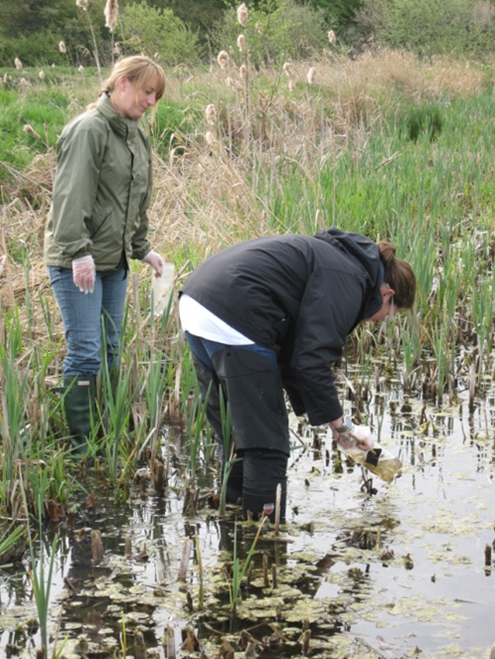
Citizen science
Helping partners to make best use of different monitoring approaches
Rapid increase in the number of projects involving volunteers in science
How should a citizen science project be designed and implemented?
Notes:
Involvement of volunteers in science isn’t new
Over the past decade there has been a rapid increase in the number of citizen science projects
Yet for many organisations there is still not a full understanding of the best use and limitations of this approach

Slide 12
Citizen Science
Contract let to CEH (lead) and NHM
Short guide produced, based on a 200 page detailed report
2500 downloads of the guide, and 1500 of the report
Top 3 of the BBC Online Science and Environment for 48 hours
Citizen Science working group established
Notes:
Very well received report
Highlights include over 200 tweets including GCSA
Example of UKEOF sharing information and knowledge to help make best use the different monitoring approaches that are available.

Slide 13
Sustainable Funding Mechanisms
Starting to address the funding issues around long-term observations
Sir John Beddington (then GCSA) convened a group to look at funding issues
UKEOF was well placed to provide evidence to support the group facilitating:
Development of a list of nationally important observations using the Catalogue
Production of 6 case studies using the Decision Support Framework
UWMN
Notes:
The list provided an idea of the scope and range of activities that may need to be dealt with (was NOT a list to prioritise funding).
Issues that the case studies demonstrated: multiple partners both national and international, no lead organisation, transition from research to long term sustained, loss of expertise.

Slide 14
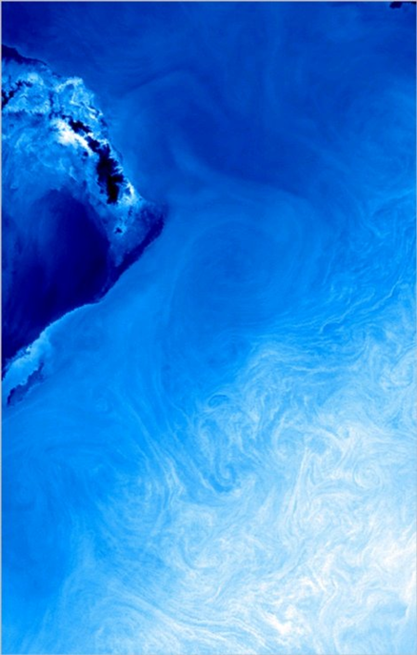
Sustainable Funding Mechanisms
A GCSA chaired Observations Committee was set up. UKEOF continues to provide evidence to support its work
The key focus of the Committee is on programmes of cross departmental interest
Notes:
Cross departmental GCSA chaired Observations Committee has now been established and first met February 2013
Sir Mark Walport has already shown his intention to continue with the Committee
Cross departmental interest: either funded by multiple organisations or funded by one organisation and considered of key importance to at least one other organisation

Slide 15
Climate Observations
Following a consultation on the GCOS Implementation Plan, led by UKEOF for DECC, it became clear that improved transparency is needed over which UK observations are being used for climate purposes
A group has now been set up to take this forward, overseeing co-ordination of UK GCOS activities:
Chaired by DECC, members from NERC, Met Office, CEH, DfiD, STFC (representing Data Centres), and the GCOS National Co-ordinator

Slide 16
Climate Observations
A report has been commissioned by the group, identifying those UK observations that contribute to GCOS
The report will be published in early 2014

Slide 17
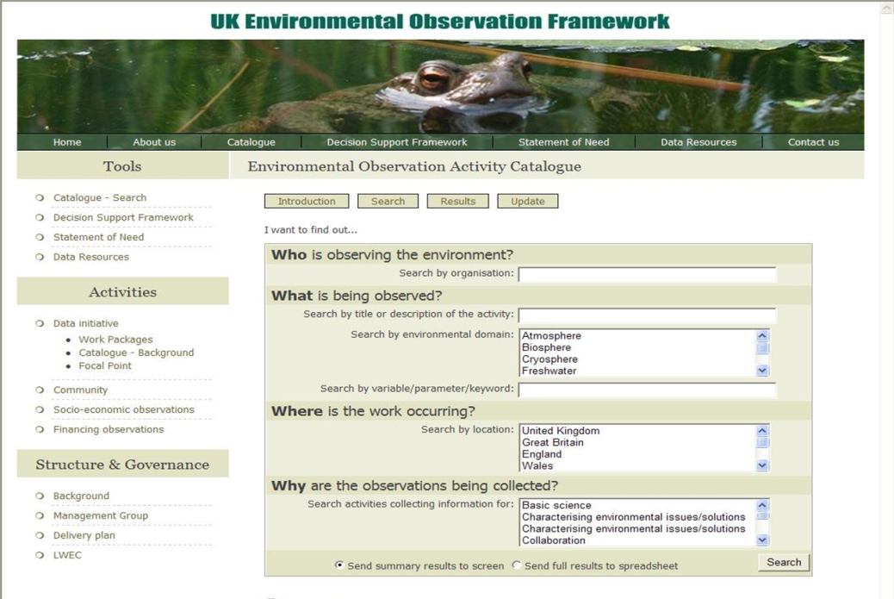
Catalogue
Holds metadata – who is doing what, where and why, of over 1200 activities
Only UK overview of environmental observations

Slide 18
Catalogue upgrade
Upgrade will provide:
Mapping function to show where activities are taking place
On-line editing tool
Catalogue will be INSPIRE Annex 3 EF Theme compliant i.e. metadata of environmental monitoring facilities
UKEOF is currently the only organisation with an EF Theme Schema: happy to share
Investigating with Defra if the schema could become the standard in the UK
Launch in Spring 2014
Notes:
The geo-location information will help organisations to see what other activities are being carried out in an area of interest.
The online editing tool will enable the entries to be more quickly and easily kept up to date by the data suppliers
The upgrade is being carried out by CEH Lancaster and started in Spring 2013. It is anticipated the revised and updated catalogue will be launched in Spring 2014

Slide 19
Where next?
NERC and Defra, as the two main funders of UKEOF, commissioned a review
5 years after the start of UKEOF it was a timely point to ensure UKEOF remained fit for purpose
Reported in April 2013
Full support by the MG of the recommendation to continue UKEOF
NERC and Defra have agreed funding until the end of 2014/15

Slide 20
Where next?
As part of the response to the review, a work plan is being developed identifying new areas of interest to multiple partners
The UKEOF Delivery Plan has also been updated and will soon be available on the website

Slide 21
Questions?

